Slide 1



GenePattern & Python
Notes:
Earlier today I mentioned that every job you run in GenePattern is programmatically accessible in Python. I also told you that I wasn’t going to make you write any code right then.
.
Well, the time has come. I this section I’m going to briefly go over the programmatic features of GenePattern.
.
The good news if you’re not a coder, is that most of the code will already be written for you in a notebook.
.
But I want to emphasize that if you are a coder, GenePattern is entirely accessible and compatible with writing your own code. So have at it, the sky’s the limit!

Slide 2
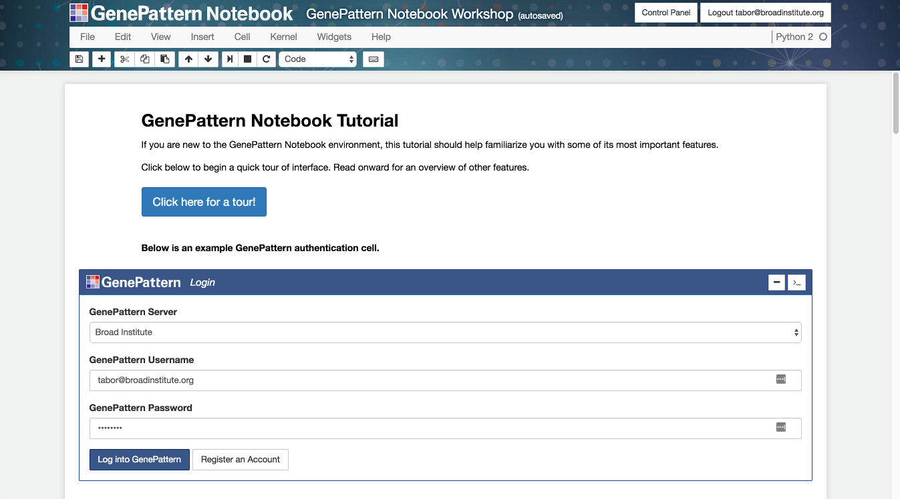
Programmatic Features Notebook
Notes:
There are going to be a number of follow-along activities in this part of the talk, so what we’re going to want to do is to grab a copy of the Programmatic Features notebook and run it.
.
We do that just like all the other notebooks we copied earlier in the day.
.
**Walk them through getting a copy of the notebook.**

Slide 3
GenePattern Python Library
Complete programmatic access
Automatic integration with GenePattern cell data
import gp
# Create a GenePattern server proxy instance
gpserver = gp.GPServer('http://localhost:8080/gp','myusername', 'mypassword')
# Obtain GPTask by module name
module = gp.GPTask(gpserver, "PreprocessDataset")
# Load module parameter data
module.param_load()
# Create a job specification
job_spec = module.make_job_spec()
# Upload a file to the server
uploaded_file = gpserver.upload_file("file_name", "/path/to/the/file/file_name")
job_spec.set_parameter("input.filename", uploaded_file.get_url())
# Submit the job to the GenePattern server
job = gpserver.run_job(job_spec)
Notes:
Under the cover, all GenePattern cells use the GenePattern Library. This library allows a user to set analysis parameters, launch GenePattern jobs, retrieve the results and import the data in a way that can be used with other popular Python libraries.
.
For example, you can run an analysis in GenePattern, retrieve the results and then use that data with Python libraries such as matplotlib, scikit-learn or pandas.
.
That is, GenePattern doesn’t import any limitations on you. If you can write code, you can use the library to perform whatever analysis you want.
.
And here you can see a bit of example code up on the screen.

Slide 4
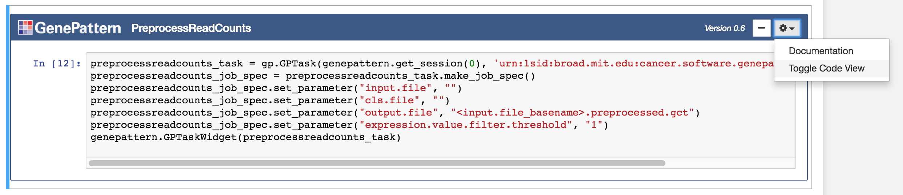
Toggle Code View
Under the cover, all GenePattern cells use the Python library.
Can view the code by selecting “Toggle Code View” in the gear menu in the upper right.
Notes:
Speaking of viewing the code, if you ever want to know exactly what a GenePattern cell is going programmatically, there’s a way to see this.
.
Every GenePattern cell has the “Toggle Code View” open in the gear menu I the upper right. If you select this option, the cell’s view changes to display the code that the cell is executing behind the scenes.
.
**Show them how to do this.**
.
If you’re trying to teach yourself Python, or trying to learn to use the GenePattern Python library, this is also a good way to view code examples and learn how the system works.

Slide 5
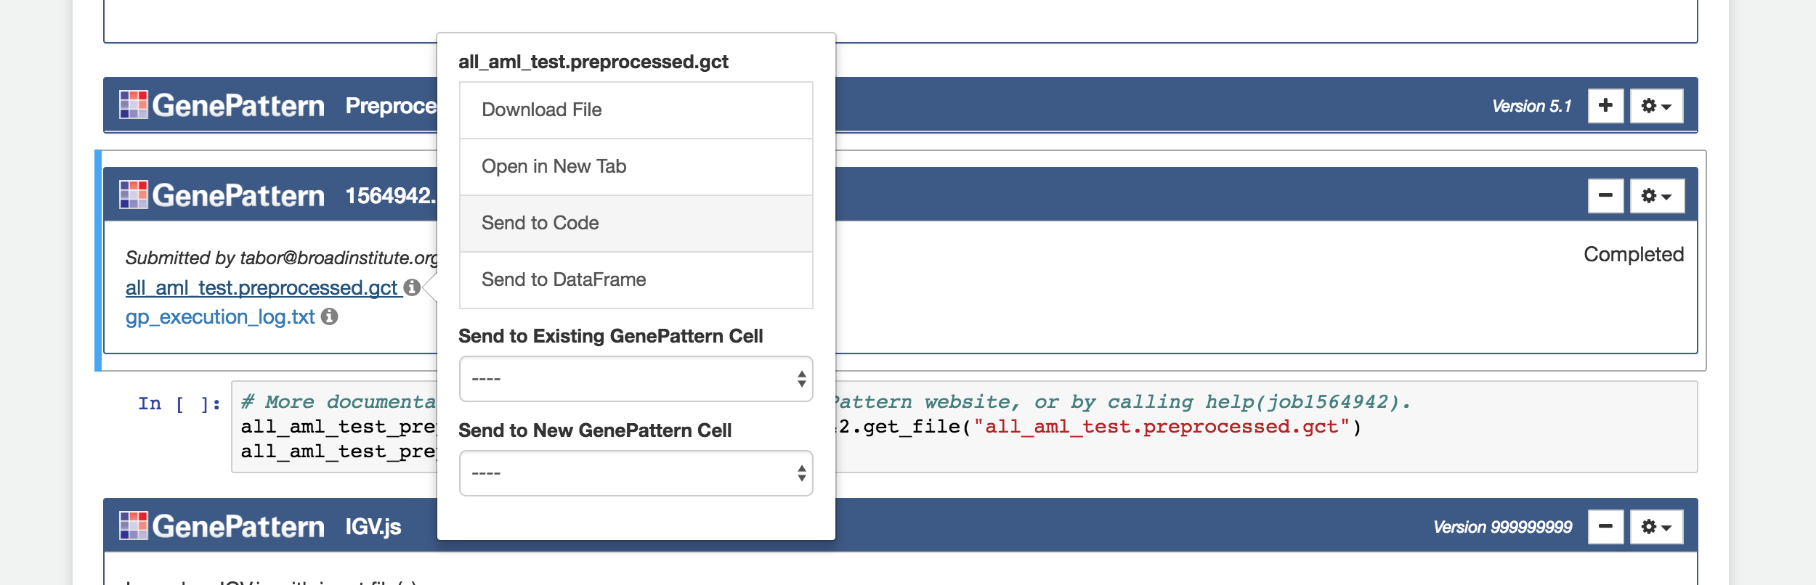
Send to Code
Example code showing how to programmatically access a GenePattern job result can be generated by clicking on the file and selecting “Send to Code.”
Notes:
And speaking of code examples, if you ever want to know how to programmatically reference a particular job result in Python, the GenePattern Notebook environment will automatically generate code snippets for you.
.
To see one snippets, just click on a result file in a completed GenePattern job cell, and you’ll see the menu. In this menu, select “Send to Code.”
.
This will create a new code cell containing an example of how to reference that particular job result.
.
**Demonstrate this.**

Slide 6
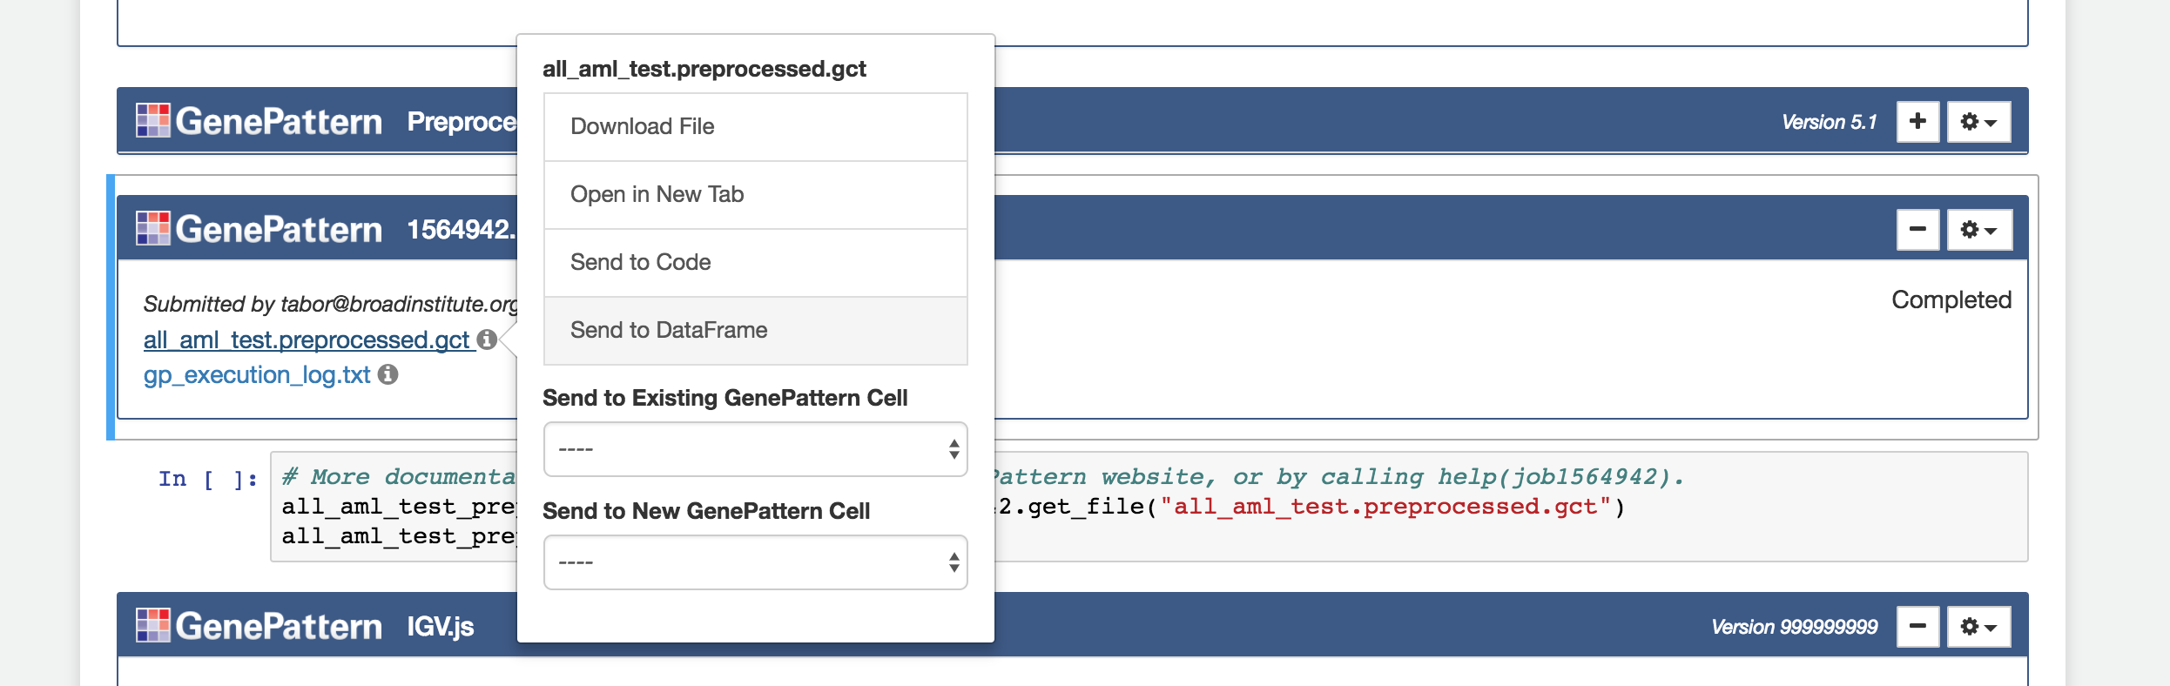
Send to Dataframe
Certain GenePattern file formats can be automatically imported into a pandas Dataframe by selecting “Send to Dataframe” in the menu.
Pandas is a popular Python library for working with data.
Notes:
For certain common GenePattern file formats—such as GCT and ODF—we go a step beyond this, generating code snippets not just for referencing a file, but also importing and indexing that data in a pandas Dataframe.
.
And for those of you who aren’t familiar with it, pandas is an extremely popular Python library for reading and working with large datasets. It’s a staple of doing most any sort of data science in Python
.
Pandas also integrates well with Jupyter and the GenePattern Notebook environment. For example, if you import a GenePattern job result into a dataframe and then return that dataframe in a code cell, the notebook will display a table containing your data.
.
**Demonstrate this.**

Slide 7
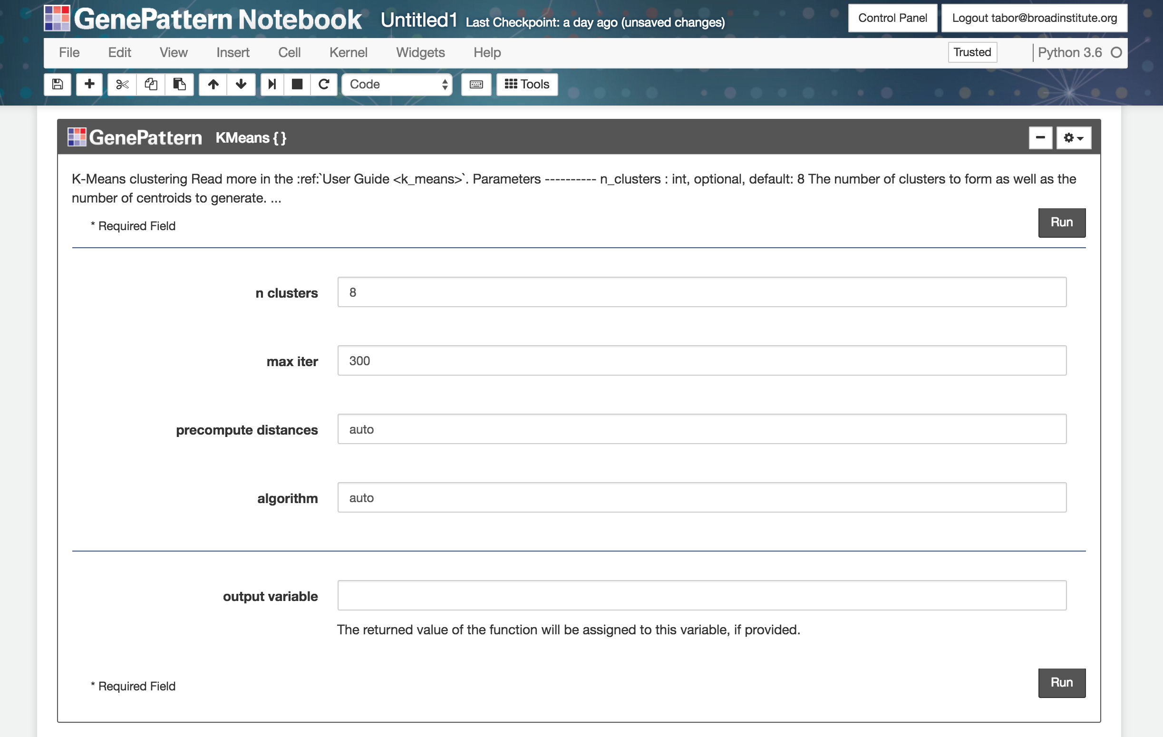
UI Builder
Turn any Python function into an interactive GenePattern widget.
Notes:
Finally, I want to talk about GenePattern’s new UI Builder functionality.
.
This is a way to turn any Python function call into an interactive GenePattern cell. With a single line of code.
.
Additionally, you can use Python variables as inputs to these calls.
.
And the next part of the notebook we have open should demonstrate this.
.
**Walk them through it.**

Slide 8
Exercise
Notes:
To round out this section we’re going to do a really short exercise.
.
And if you scroll down in your notebook, you should see the exercise already set up in it.

Slide 9
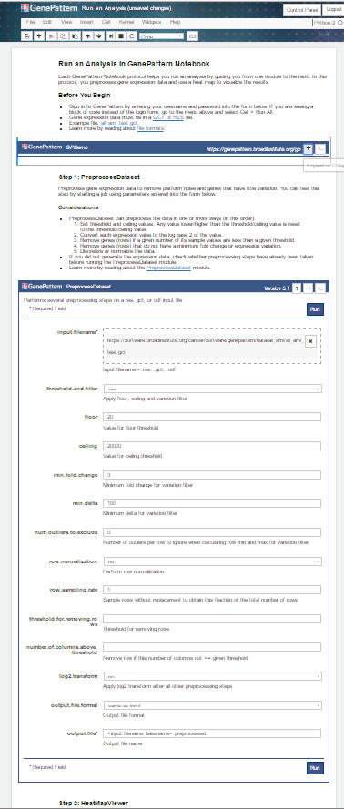
Python Exercise
Display and manipulate Dataframe
Notes:
What we’re going to do, is we’re going to load a GenePattern result file into a pandas dataframe, and then we’re going to pass that dataframe to a UI Builder cell, which will sort and display the results.
.
So just follow along with the directions in the notebook.
.
**Help people out and then demonstrate how to do it.**

Slide 10
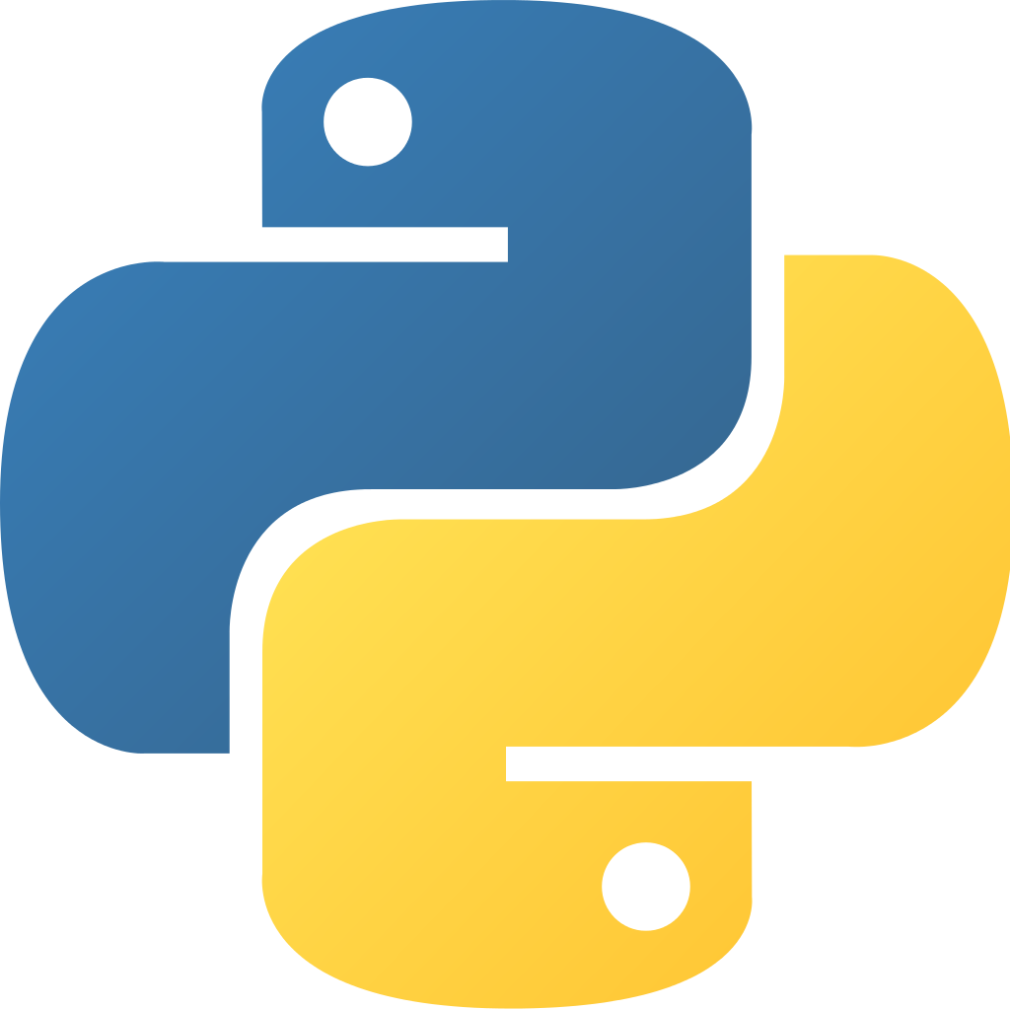


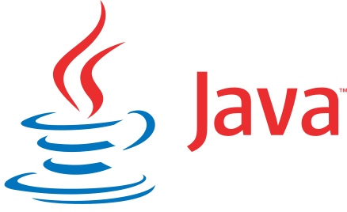

Other Programmatic Support
Libraries for Python, R, MATLAB & Java
REST API
Used to back portals and other web applications
Notes:
So to close this part of the talk, I want to briefly mention some of the other programmatic that are available.
.
For example, if Python isn’t your language of choice. Programmatic GenePattern libraries are also available in R, MATLAB and Java.
.
Additionally, GenePattern provides a RESTful web service, and this API is actively used to back a variety academic portals and other web applications.
.
In fact, if none of the languages I just mentioned suit your fancy, the REST API can be called from any language of your choice.

